Slide 1
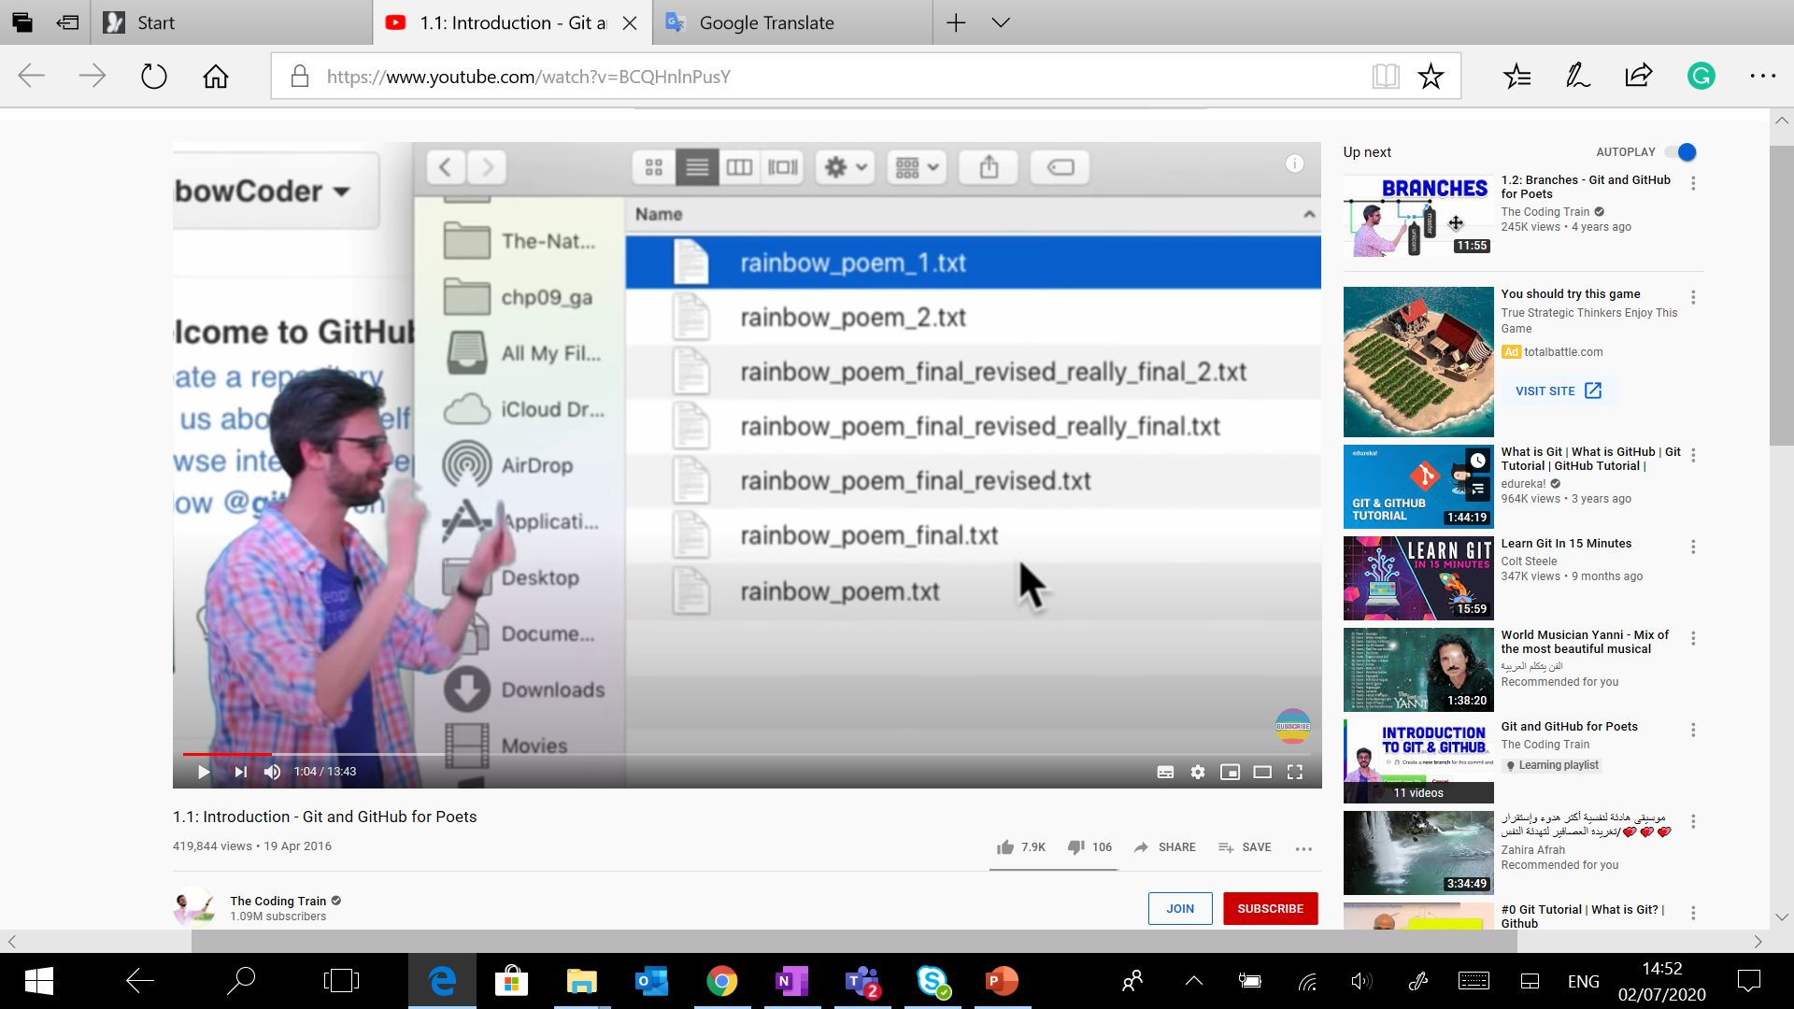
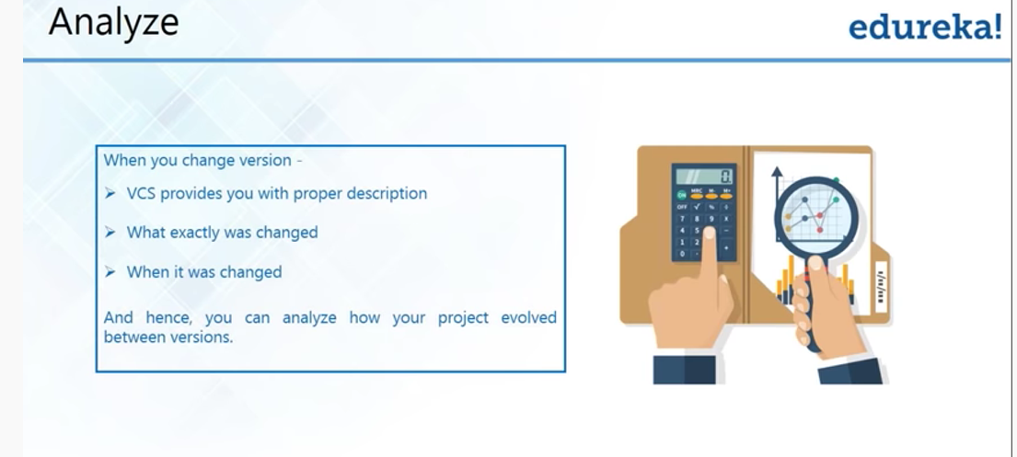
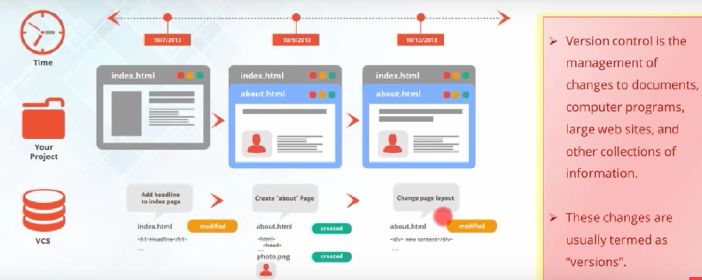
The version control system is dealing with the changes that leads to the managements of versions in coding. The software exists to run different versions determine in which version(s) the problem occurs.The multiple version may be necessary to the development and and locate and fix the inficted system. The feature work require trunck while other version is new feature with branches. The version often occur in the example of doc file go under series files names for the development of version. The files contained series number of versions. The files often initiate to the project of many files and end with folder of difrrent files. The folder represent as repository. The determine of file locatin via folder require directory path while in repository requires section this one lead to arbitrary organised tree.

Slide 2
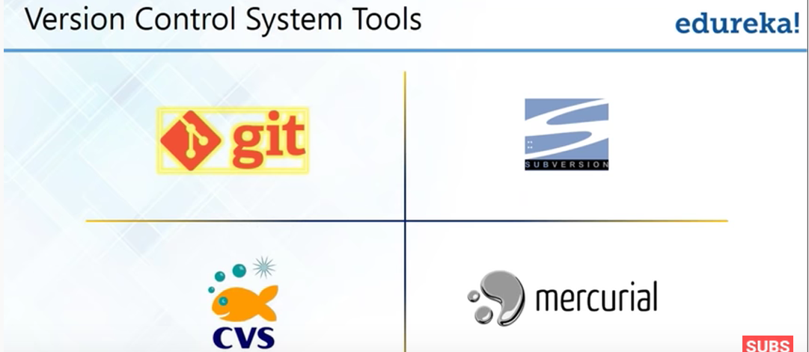

Slide 3
Original developer | Linus Torvalds (developed for Linux kernel code control) | CollabNet, Inc
Git and SVN both have the dominion enterprise over version control systems (VCS) that design the repository . (VCS) is designed to workflow and project management in coding.
The repositories is a project but as in SVN is designed to architecture of arbitrary subtree. On the other hand, the git is for the whole repository .
The project is organized within specific subdirectories, such as trunk, branches, and tags.
Storage format | Metadata | Files
Branching | Branches are references to a certain commit. They can be created, deleted, and changed at any time without affecting other commits. | Branches are created as directories inside a repository and when the branch is ready, it is committed back to the trunk.
Change tracking | Repository level | File level
Access control & permissions | Assumes all contributors have the same permissions to the entire codebase. | Allows for granular permissions with read and write access controls per file level and per directory level.

Slide 4
SVN project store in the workflow of features : the directory labeled into commit of project and project refences to specific subdirectories.
Git projects are also stored within workflow of git features : a single directory with a special .git directory. For example, a Git project with two features
sample_project/.git
sample_project/README.md
sample_project/lib/widget.rb
sample_project/trunk/README.md
sample_project/branches/new_feature/README.md
A Git repository stores the full history of all of its branches and tags within the .git directory.
The latest stable release is contained within the master branch.
Active feature work is developed in separate branches.
When a feature is finished, the feature branch is merged into master and deleted.
The SVN workflow :
The trunk directory represents the latest stable release of a project.
Active feature work is developed within subdirectories under branches.
When a feature is finished, the feature directory is merged into trunk and removed.

Slide 5
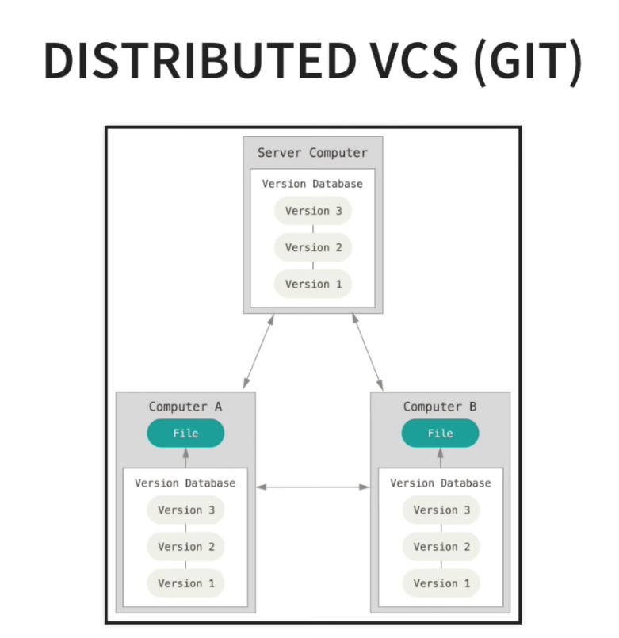
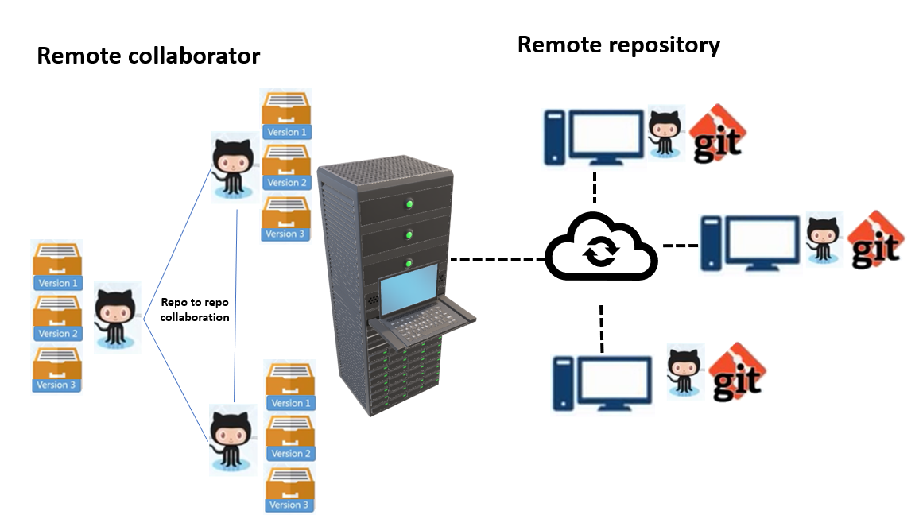
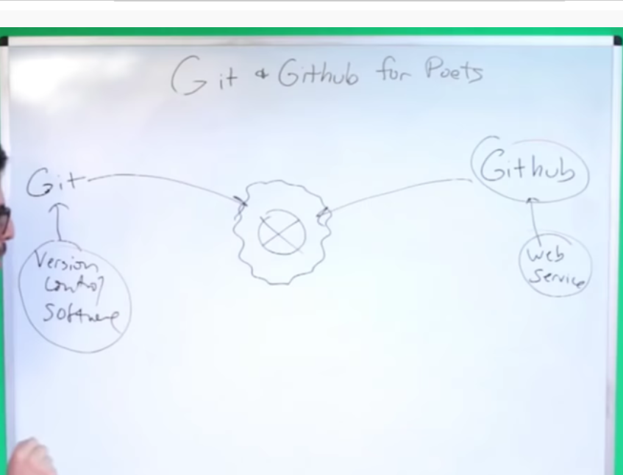
Git is a distributed version control system, distributed system act as client and server. The process is the repo to repo collaboration. developers can have the entire copy of the full version history project on… If the user act as client, the sever rpresent as centralized repository . If the user act as server, the client represent their local repositories
developer doesn’t have to be connected all the time
check out files and commit changes back to the server.

Slide 6
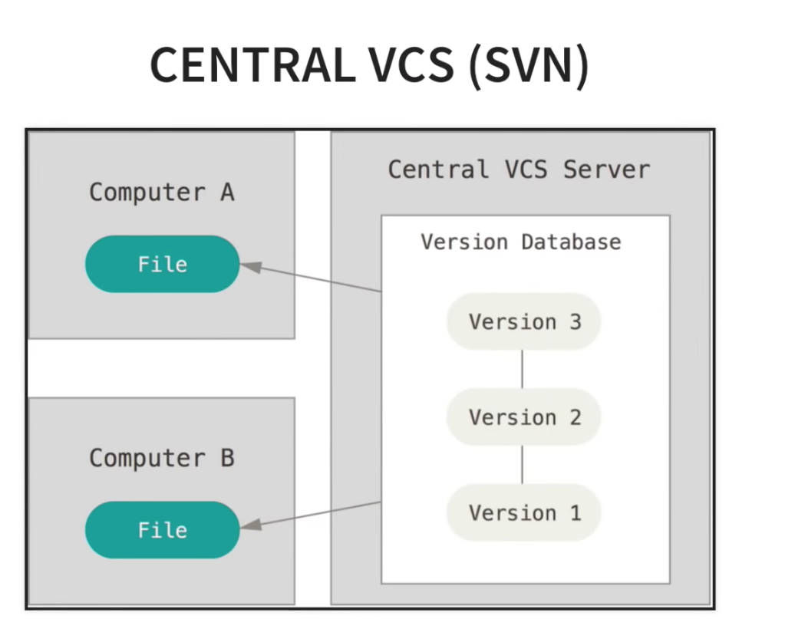
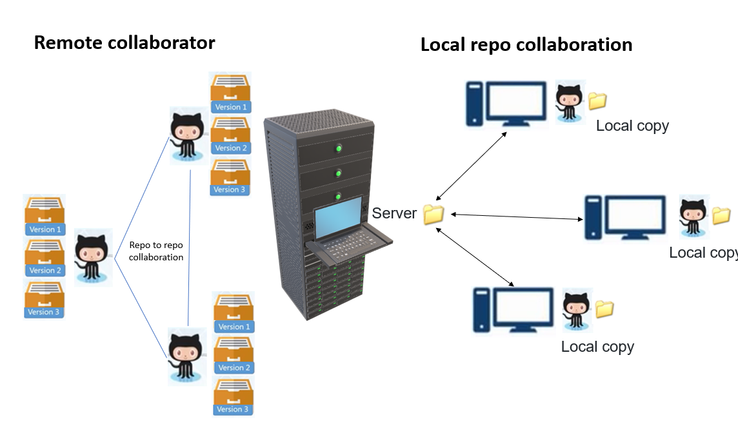
SVN is centralised system separated act as the server and client. The process is repo to working copy collaboration. The storage format is file and the check out files and commit changes back to the server. The developer must be online. The right side the server is a centralised Repo and the client represent as local copy.

